Slide 1

IF351 DATABASE SYSTEMS
10 STORED PROCEDURES AND ADVANCED SQL QUERY (CTE)
DENNIS GUNAWAN
DAVID AGUSTRIAWAN

Slide 2
OUTLINE
Stored Procedures
Local Variables
Flow-Control Statements
Querying Data with SELECT INTO
MySQL Delimiter
CTEs
SQL Window Function

Slide 3
STORED PROCEDURES
A certain piece of code (the procedure) consisting of declarative and procedural SQL statements
stored in the catalog of a database
that can be activated by calling it
from a program, a trigger, or another stored procedure
CREATE PROCEDURE statement consists of several
other SQL statements
Each stored procedure consists of at least 3 parts
A name
A list of parameters
A body

Slide 4
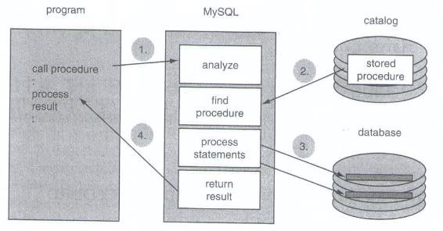
THE PROCESSING STEPS OF A STORED PROCEDURE
The process begins when the procedure is called from the program
The database server receives this call and finds the matching procedure in the catalog
The procedure is executed
When the procedure is finished, the result of the procedure is returned
No communication takes place between the database server and the program during the execution of the procedure

Slide 5
THE PARAMETERS OF A STORED PROCEDURE
A stored procedure has zero, one, or multiple parameters
Through these parameters, the procedure is capable of communicating with the outside world
3 types of parameters
With input parameters, data can be passed to a stored procedure
The stored procedure uses output parameters when an answer or result must be returned
Input/output parameter can act as an input as well as an output parameter

Slide 6
THE PARAMETERS OF A STORED PROCEDURE
CREATE PROCEDURE procedure_name
( [ [ IN | OUT | INOUT ] parameter_name data_type, [ IN | OUT | INOUT ] parameter_name data_type,
...] )
routine_body
CREATE PROCEDURE delete_actor ( IN actor_id CHAR(5) )
...
CREATE PROCEDURE show_all_movies ()
...
A stored procedure does not need parameters, but opening and closing brackets are still required

Slide 7
THE BODY OF A STORED PROCEDURE
The body of a stored procedure contains all the statements that must be executed when the procedure is called
The body always begins with BEGIN and ends with END
In between, all statement types can be specified
SQL statements (DDL, DCL, and DML statements)
Procedural statements, such as IF-THEN-ELSE and WHILE-DO

Slide 8
THE BODY OF A STORED PROCEDURE
CREATE PROCEDURE delete_actor ( IN actor_id CHAR(5) )
BEGIN
DELETE
FROM actors
WHERE id = actor_id;
CREATE PROCEDURE procedure_name
( [ | [ IN | | OUT | | | INOUT | ] | parameter_name | data_type,
 | [ IN | | OUT | | | INOUT | ] | parameter_name | data_type,
 | ...] | )
END
BEGIN
body_statement
END
CREATE PROCEDURE show_all_movies () BEGIN
SELECT id, name, year, rank FROM movies;
END

Slide 9
LOCAL VARIABLES
Within a stored procedure, local variables can be declared
They can be used to store temporary intermediate results
If we need a local variable within a stored procedure, we must introduce it first with a DECLARE statement
With a declaration, the data type of the variable is determined, and an initial value can be specified

Slide 10
LOCAL VARIABLES
DECLARE variable_name, variable_name, ... data_type
[ DEFAULT default_value ];
DECLARE score DECIMAL(5,2);
DECLARE name VARCHAR(40);
DECLARE number1, number2 INTEGER;
DECLARE number1 INTEGER DEFAULT 100;

Slide 11
THE SET STATEMENT
SET statement can assign a value to a local variable
SET variable_name { variable_name { ...; |  |  | = = | | := | := | } } | scalar_expression, scalar_expression,
SET SET SET | var1 var1 var1 | = 1; := 1; = 1, var2 | = var1;

Slide 12
FLOW-CONTROL STATEMENTS: IF STATEMENT
CREATE PROCEDURE odd_or_even ( IN number INTEGER )
BEGIN
DECLARE output VARCHAR(255);
SET output = ‘’;
ELSE
SET output = CONCAT(number,‘ ’,‘is an odd number’);
IF number % 2 | = | 0 THEN
SET output | = | CONCAT(number,‘ | ’,‘is | an even number’);
END IF;
SELECT output “Odd Or Even?”;
END
IF condition THEN statement_list
[ ELSEIF condition THEN statement_list ]
[ ELSEIF condition THEN statement_list ]
...
[ ELSE statement_list ] END IF;

Slide 13
FLOW-CONTROL STATEMENTS: CASE STATEMENT
CREATE PROCEDURE odd_or_even ( IN number INTEGER )
BEGIN
DECLARE output VARCHAR(255);
SET output = ‘’; CASE number % 2 WHEN 0 THEN
SET output = CONCAT(number,‘ ’,‘is an even number’);
ELSE
SET output = CONCAT(number,‘ ’,‘is an odd number’);
END CASE;
SELECT output “Odd Or Even?”;
END
CASE scalar_expression
WHEN scalar_expression THEN statement_list
[ WHEN scalar_expression THEN statement_list ]
...
[ ELSE statement_list ] END CASE;

Slide 14
FLOW-CONTROL STATEMENTS: CASE STATEMENT
CREATE PROCEDURE odd_or_even ( IN number INTEGER )
BEGIN
DECLARE output VARCHAR(255);
SET output = ‘’;
CASE
WHEN number % 2 = 0 THEN
SET output = CONCAT(number,‘ ’,‘is an even number’);
ELSE
SET output = CONCAT(number,‘ ’,‘is an odd number’);
END CASE;
SELECT output “Odd Or Even?”;
END
CASE
WHEN condition THEN statement_list
[ WHEN condition THEN statement_list ]
...
[ ELSE statement_list ] END CASE;

Slide 15
FLOW-CONTROL STATEMENTS: WHILE STATEMENT
[ label_name : ] WHILE condition DO statement_list
END WHILE [ label_name ];
CREATE PROCEDURE show_numbers ( IN upper_limit INTEGER ) BEGIN
DECLARE i INTEGER;
CREATE TEMPORARY TABLE sequence_numbers (numbers INTEGER);
SET i = 0;
WHILE i < upper_limit DO
INSERT INTO sequence_numbers(numbers) VALUES(i+1); SET i = i + 1;
END WHILE;
SELECT numbers “Numbers” FROM sequence_numbers; DROP TEMPORARY TABLE sequence_numbers;
END

Slide 16
FLOW-CONTROL STATEMENTS: REPEAT STATEMENT
CREATE PROCEDURE show_numbers ( IN upper_limit INTEGER )
BEGIN
DECLARE i INTEGER;
CREATE TEMPORARY TABLE sequence_numbers (numbers INTEGER); SET i = 0;
REPEAT
INSERT INTO sequence_numbers(numbers) VALUES(i+1);
SET i = i + 1;
UNTIL i >= upper_limit END REPEAT;
SELECT numbers “Numbers” FROM sequence_numbers; DROP TEMPORARY TABLE sequence_numbers;
END
[ label_name : ] REPEAT statement_list
UNTIL condition
END REPEAT [ label_name ];

Slide 17
FLOW-CONTROL STATEMENTS: LOOP, LEAVE, & ITERATE STATEMENT
CREATE PROCEDURE show_odd_numbers ( IN upper_limit INTEGER )
BEGIN
DECLARE i INTEGER;
CREATE TEMPORARY TABLE odd_numbers (numbers INTEGER); SET i = 0;
odd: LOOP
SET i = i + 1;
IF i > upper_limit THEN LEAVE odd; END IF; IF i % 2 = 0 THEN ITERATE odd; END IF;
INSERT INTO odd_numbers(numbers) VALUES(i); END LOOP odd;
SELECT numbers “Numbers” FROM odd_numbers; DROP TEMPORARY TABLE odd_numbers;
END
[ label_name : ] LOOP
statement_list
END LOOP [ label_name ];
LEAVE label_name;
ITERATE label_name;

Slide 18
CALLING STORED PROCEDURES
A procedure can be called from a program, from interactive SQL, and from stored procedures
The CALL statement is used
CALL [ database_name. ] stored_procedure_name ( [ parameter, parameter, ... ] );
CALL delete_actor (‘A0001’);
CALL show_all_movies ();

Slide 19
QUERYING DATA
Quite often we want to retrieve data from the tables into the stored procedure
We can fetch data in two ways
If only one-row data must be fetched, we can easily do this with a special version of the SELECT statement: the SELECT INTO statement
To fetch multiple rows, the concept of a cursor has been added

Slide 20
QUERYING DATA WITH SELECT INTO
SELECT |  | ...
INTO |  | local_variable, local_variable, ...
FROM |  | ...
WHERE |  | ...
GROUP | BY | ...
In the INTO clause, we specify the names of
variables
For each expression in the SELECT clause, a variable must be specified
HAVING ...
ORDER BY ...
LIMIT ...;
After processing the SELECT INTO statement, the values of that expression are assigned to the variables

Slide 21
QUERYING DATA WITH SELECT INTO
CREATE PROCEDURE count_actors ( OUT counter INTEGER ) BEGIN
SELECT COUNT(*)
INTO counter FROM actors;
END
CALL count_actors (@number_of_actors);
SELECT @number_of_actors;

Slide 22
REMOVING STORED PROCEDURES
Stored procedures can be removed from the catalog using DROP PROCEDURE statement
DROP PROCEDURE [IF EXISTS] [database_name.] procedure_name;
DROP PROCEDURE delete_actor;
DROP PROCEDURE show_all_movies;

Slide 23
MYSQL DELIMITER
Each stored program contains a body that consists of an SQL statement
This statement may be a compound statement made up of several statements separated by semicolon ( ; ) characters
By default, MySQL itself recognizes the semicolon as a statement delimiter
You must redefine the delimiter temporarily to cause MySQL to pass the entire stored program definition to the
server

Slide 24
MYSQL DELIMITER
To redefine the MySQL delimiter, use the DELIMITER command
DELIMITER //
CREATE PROCEDURE show_all_movies ()
BEGIN
SELECT id, name, year, rank FROM movies;
END//
DELIMITER ;

Slide 25
Definition of CTEs
A Common Table Expression (CTE) is like a named subquery. It functions as a virtual table that only its main query can access. CTEs can help simplify, shorten, and organize your code
CTE provide a way to break down complex queries into more manageable and understandable parts, improving readability and maintainability
Common Table Expressions (CTEs) are a valuable feature in SQL that provides a way to organize and simplify complex queries. They are particularly useful for recursive queries, data transformation, code reusability, and improving query readability. By mastering CTEs, SQL developers can write more efficient and maintainable code for handling diverse data processing tasks

Slide 26
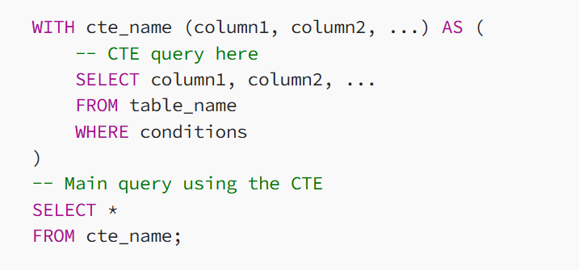
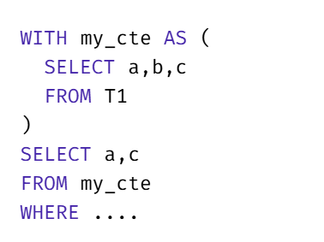
Syntax of CTEs

Slide 27
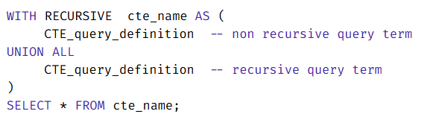
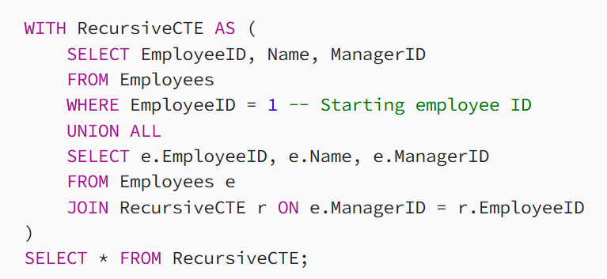
Recursive CTEs
Suppose we have a table Employees with columns EmployeeID, Name and ManagerID where ManagerID refers to the EmployeeID of the manager. We can use a recursive CTE to retrieve the hierarchical structure of employees and their managers
This recursive CTE starts with the employee whose EmployeeID is 1 and then recursively retrieves all employees reporting to that employee and their managers

Slide 28
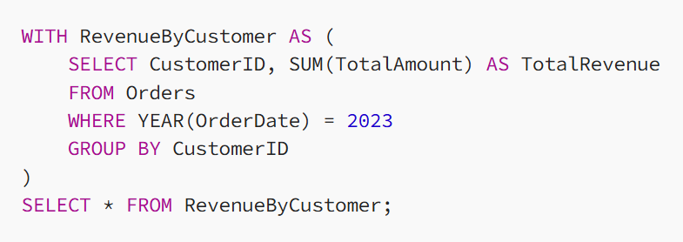
Data Transformation CTEs
Suppose we have a table Orders with columns OrderID, CustomerID, OrderDate and TotalAmount. We want to calculate the total revenue generated by each customer in the year 2023
In this example, the CTE RevenueByCustomer calculates the total revenue for each customer in the year 2023, and then the main query selects and displays the results

Slide 29
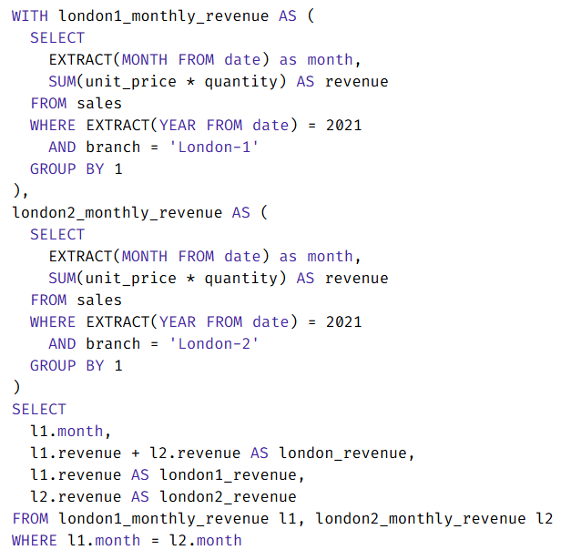
Defines two or more CTEs and use them in main query
The query define two CTEs, london1_monthly_revenue and london2_monthly_revenue, to obtain the monthly revenue in 2021 for each branch in London.
Finally, it joins both CTEs using the month column and calculate the total revenue for London by adding up the revenues of the two branches

Slide 30
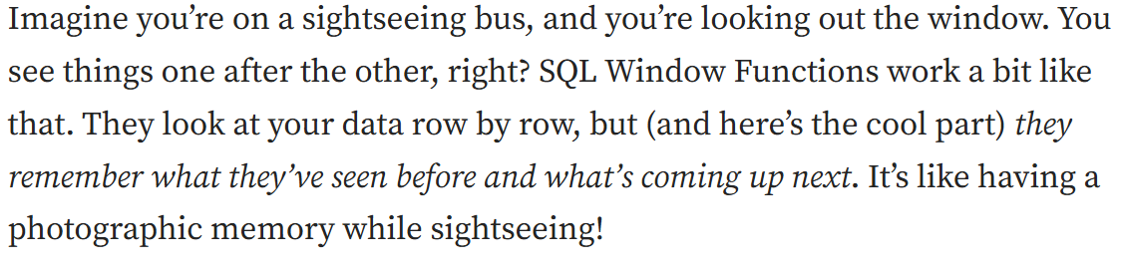
Definition of SQL Window Function
A window function performs a calculation across a set of table rows that are somehow related to the current row.
This is comparable to the type of calculation that can be done with an aggregate function. But unlike regular aggregate functions, use of a window function does not cause rows to become grouped into a single output row — the rows retain their separate identities. Behind the scenes, the window function is able to access more than just the current row of the query result.

Slide 31
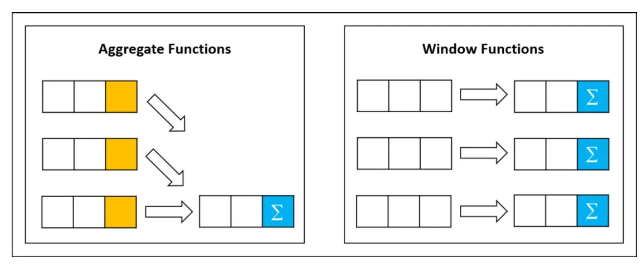
Definition of SQL Window Function

Slide 32
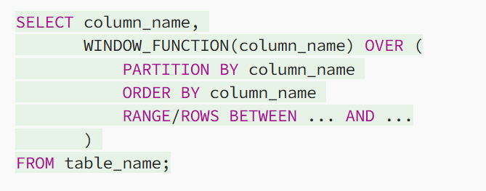
Anatomy of a Window Function

Slide 33
Anatomy of a Window Function
The Function: This could be a SUM, AVG, MAX, or any other function you need. It’s generally the heart of the (mathematical) operation that you want to perform! These are similar to regular aggregate functions but do not reduce the number of rows returned.
OVER(): This part lets SQL know that we’re about to do something special, setting the stage for our Window Function. OVER()is the cornerstone of window functions in SQL. This clause empowers us to designate a “window” or a subset of data that the function will process
PARTITION BY: (Optional) If you want to perform your calculations on specific chunks (groups) of your data, this is how you tell SQL to divide things up. If no PARTITION BY is specified, the function treats all rows of the query result set as a single partition. It works similarly to the GROUP BY clause, but while GROUP BY aggregates the data, PARTITION BY doesn’t, it just groups the data for the purpose of the window function
ORDER BY: (Optional) This orders the rows within each partition. If no ORDER BY is specified, the function treats all rows of the partition as a single group.

Slide 34
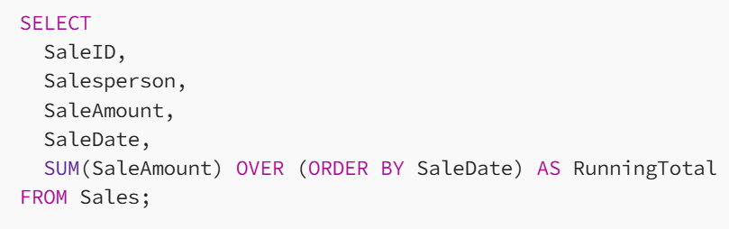
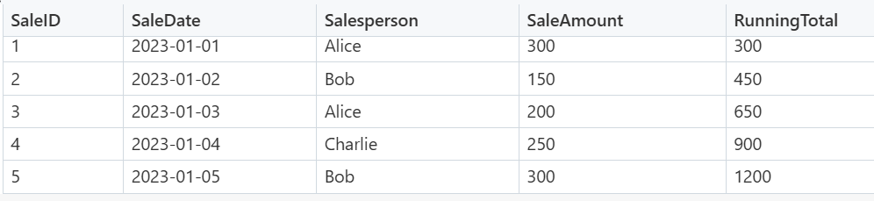
Window Function: Running Total
This will calculate the running total of SaleAmount for each row ordered by SaleDate

Slide 35
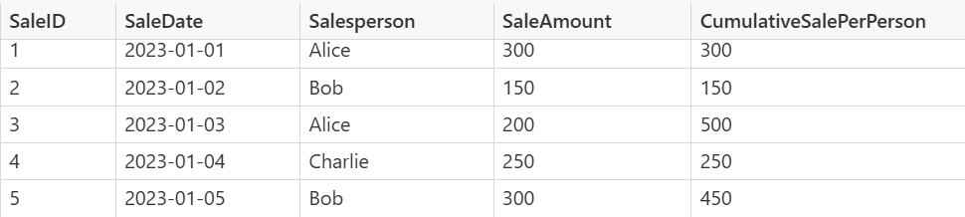
Window Function: Cumulative totals (by SalesPerson)
SELECT SaleID, Salesperson, SaleAmount, SaleDate, SUM(SaleAmount) OVER (PARTITION BY Salesperson ORDER BY SaleDate) AS CumulativeSalePerPerson FROM Sales;
Now what if we wanted to see how each member of the Sales team was evolving over time? It is quite important to keep track of numbers (AKA Quotas) in a Sales team, so we may have a different requirement of actually calculating something like a Running Total not for the whole dataset, but rather for each person on the team

Slide 36
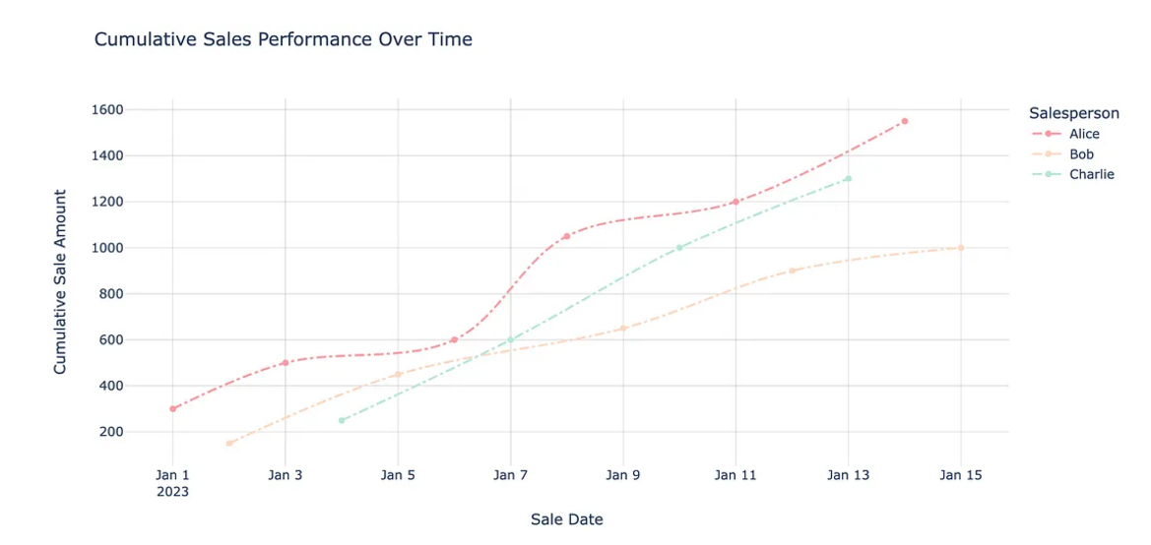
Window Function: Visualisation of Cumulative totals (by SalesPerson)

Slide 37
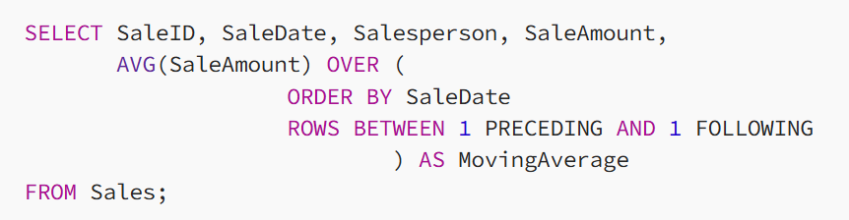
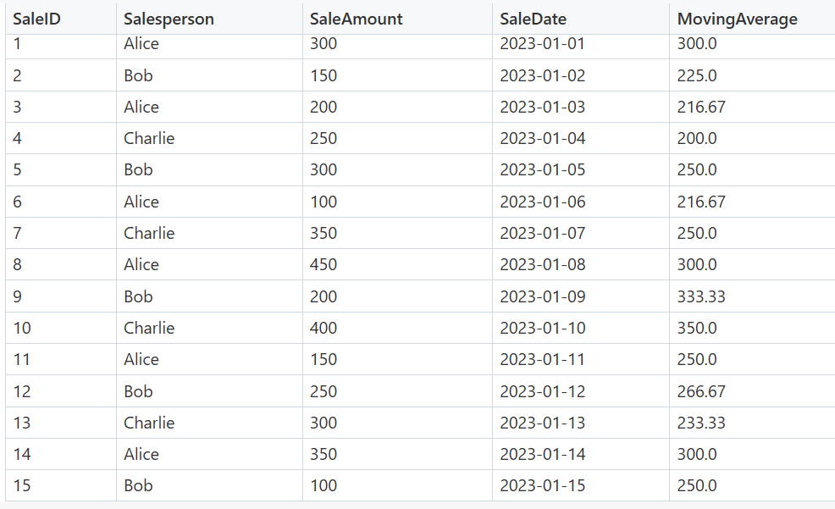
Window Function: Three days Salesamount
We used ROWS BETWEEN 1 PRECEDING AND 1 FOLLOWING to look at the day before and the day after each row (AKA our “Window”). This is probably the most relevant reason why anyone even thought to call these functions by this name!

Slide 38
REFERENCES
Elmasri, Ramez and Shamkant B. Navathe (2016), Fundamentals of Database Systems, 7th edition, Addison Wesley.
Rick F. van der Lans (2007), SQL for MySQL Developers, Addison Wesley.
Connolly,Thomas and Carolyn Begg (2015), Database Systems A Practical Approach to Design, Implementation, and Management, 6th edition, Pearson Education, ISBN 13: 978-1-292-06118-4, Essex, England.
https://learnsql.com/blog/what-is-common-table-expression/
https://medium.com/@roshmitadey/common-table-expressions-cte-in-sql-abdf550fc72f
https://medium.com/@manutej/mastering-sql-window-functions-guide-e6dc17eb1995
https://mode.com/sql-tutorial/sql-window-functions

Slide 39
SELECT * FROM WORLD
WHERE SOMEONE LIKE ‘%YOU%’;
EMPTY SET (0.00 SEC)

Slide 40

Vision
To become an outstanding undergraduate Computer Science program that produces international-minded graduates who are competent in software engineering and have entrepreneurial spirit and noble character.
I N F O R M A T I K A
Mission
To conduct studies with the best technology and curriculum, supported by professional lecturer
To conduct research in Informatics to promote science and technology
To deliver science-and-technology-based society services to implement science and technology

